Slide 1

03
Model

Slide 2
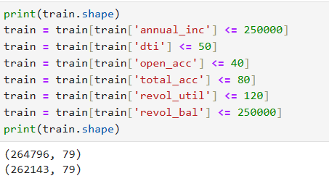
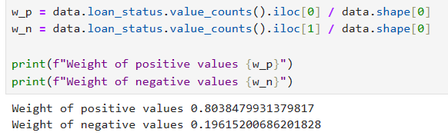
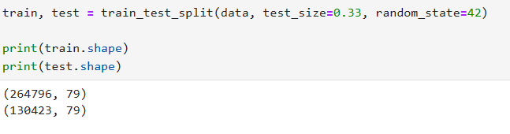
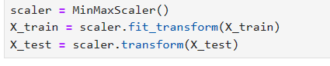
Train & test split
We first look at the distribution of both positive and negative values .
model
We can remove outliers detected by EDA part.
Finally we do the min-max normalization.
We can see that after split , the shape of train set and test set.

Slide 3
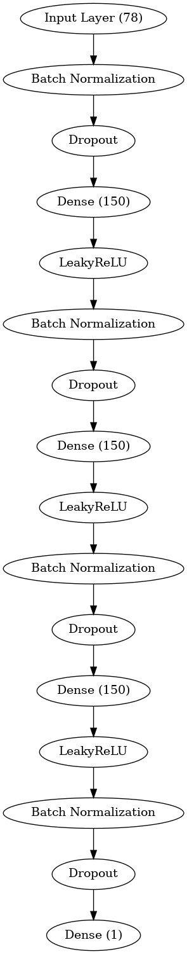
Artificial Neural Networks model
This neural network model is a multilayer perceptron (MLP) designed for binary classification tasks, specifically suited for loan default prediction. In this project, the network effectively prevents overfitting and improves training stability by using LeakyReLU activation functions, L2 regularization, dropout, and batch normalization. The output layer uses the Sigmoid activation function to output probabilities, which are used to predict whether a borrower will default. The model is trained using the Adam optimizer and binary cross-entropy loss function, with AUC as the evaluation metric to assess the model's performance at different thresholds. In the loan default prediction task, this network accurately learns from the sample features and makes reliable predictions based on borrowers' historical data, providing valuable support for loan risk assessment.
model

Slide 4
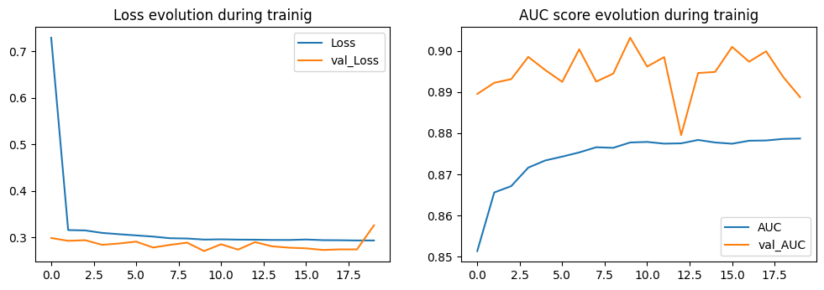
Artificial Neural Networks model
model
On the loss diagram we can see that the model achieve a low Loss after training , but may overfitting.
On the AUC diagram we can see that the model on the train is smooth , but fluctuate on validate set.

Slide 5
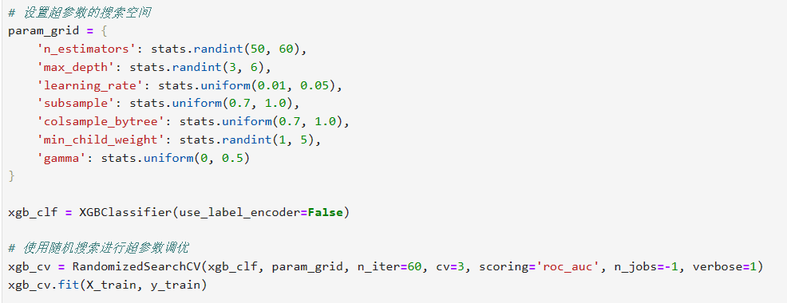
XGBoost model
XGBoost is used to predict the likelihood of loan defaults. XGBoost is a powerful gradient boosting tree model. During the model training process, we use RandomizedSearchCV for hyperparameter optimization, randomly selecting different combinations within a specified hyperparameter search space to find the best model configuration. improving the model's performance. Additionally, we enable GPU acceleration with the gpu_hist tree method, further speeding up the model's training process. Finally, we train the model with the optimized hyperparameters and evaluate its performance on both the training and test datasets.
Grid_search
model

Slide 6
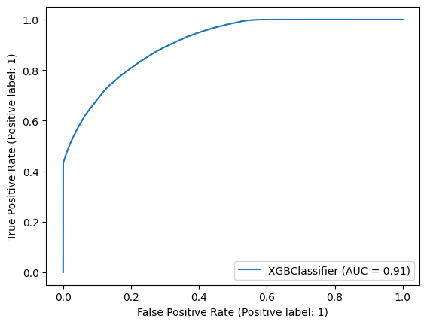
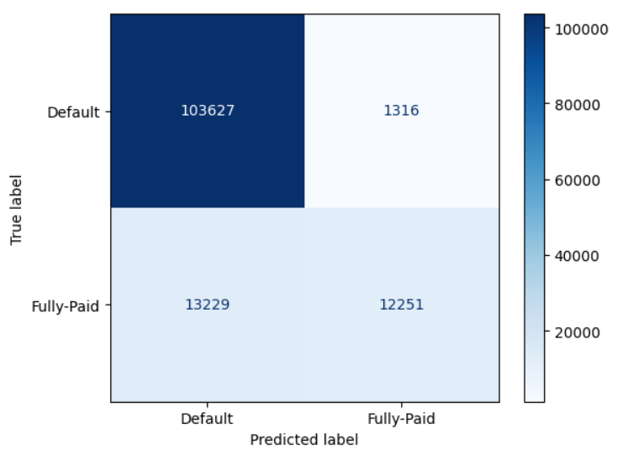
XGBoost model
Train Result:
==========================================Accuracy Score: 89.60%
Confusion Matrix:
[[208851 1627]
[ 25638 26027]]
Test Result:
==========================================Accuracy Score: 88.85%
_______________________________________________
Confusion Matrix:
[[103627 1316]
[ 13229 12251]]
model

Slide 7
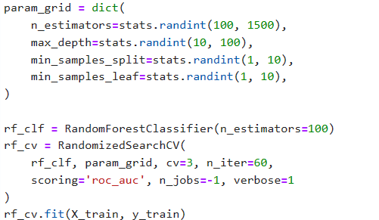
Random Forest model
Grid_search
In this project, Random Forest is used to predict loan defaults. Random Forest is an ensemble learning method that creates multiple decision trees and merges them to obtain a more accurate and stable prediction. we use RandomizedSearchCV to perform hyperparameter tuning by randomly sampling from a specified hyperparameter space. Very similar to XGBoost.
model

Slide 8
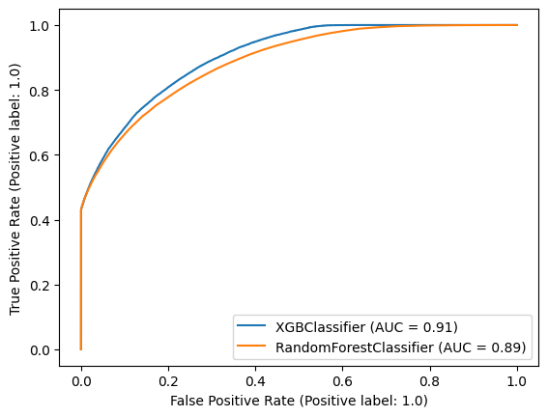
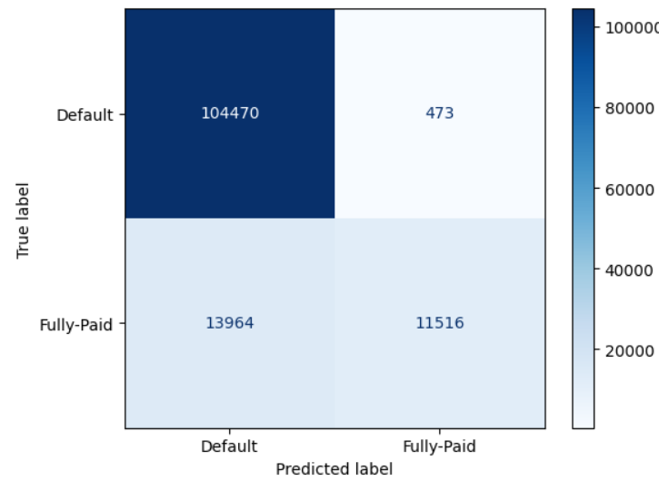
Random Forest model
Train Result:
==========================================Accuracy Score: 100.00%
_______________________________________________
Confusion Matrix:
[[210478 0]
[ 1 51664]]
Test Result:
==========================================Accuracy Score: 88.93%
_______________________________________________
Confusion Matrix:
[[104470 473]
[ 13964 11516]]
model

Slide 9
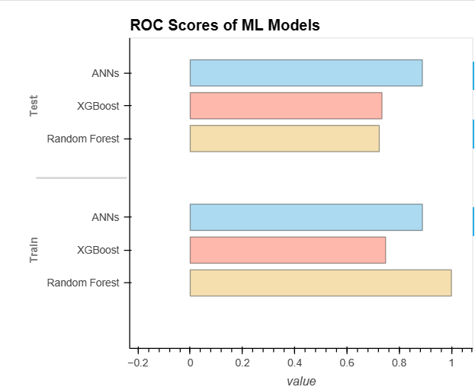
Conclusion
XGBoost underperforms on the train set, likely due to suboptimal hyperparameter tuning, but its good test set performance demonstrates its reliability and generalization capability for handling complex data.
Random Forest performs excellently on the train set but shows significant overfitting, resulting in the poorest performance on the test set.
ANNs is the best choice for this project, especially due to its superior performance on the test set, with strong generalization ability.
model

Slide 10
Thanks for your attention.
CHEN Yanxin、YU Yawen、CHEN Yijun

